Slide 1

Applications Development with C++
Course Introduction
SoftUni Team
Technical Trainers
Software University
https://about.softuni.bg

Slide 2
Table of Contents
Course Objectives
Course Scope
Exam
Course Organization
Course Infrastructure
Evaluation Criteria
Training Team

Slide 3
Have a Question?
sli.do
#app-dev-cpp
Notes:
3

Slide 4

Course Curriculum

Slide 5
Applications Development with C++ - The Curriculum
Ubuntu basics, CMake tool and SDL2 library
SDL2 library runtime. Window handling
Mouse and Keyboard events. The main loop
Image layering and Hardware Accelerated Rendering
Scaling and Alpha Blending
Texts and Colors
Improved encapsulation – Managers

Slide 6
Applications Development with C++ - The Curriculum
Sprite animations, rotation and flipping effects
Buttons & Timers
Game (1/4) - Object Layout
Game (2/4) - Core Logic and Utilities
Game (3/4) – Features and Animations
Game (4/4) - Performance optimizations
Final project assignment preparation

Slide 7

Exam

Slide 8
Practical Exam - Project
Project – upload in the course page 4 days before the Project Defense date
Upload due date (Regular): 30 Nov 2021
Upload due date (Retake): 7 Dec 2021
Project Defense in Discord
Support in Discord and sli.do during the exam

Slide 9
Theoretical Exam
You will have 30 minutes once you enter
Multiple-choice with 1 or more correct answers
English
Automated quiz system
Available during the project defense time scope
You can submit your answers just one time
You can navigate through the questions

Slide 10

Course Organization

Slide 11
Course Timeline
5-Oct-2021
4-Dec-2021
11-Dec-2021
Applications Development with C++
7 weeks * 2 times / week
12 credits
Start: 5-Oct-2021
Theoretical Exam: 4-Dec-2021
Practical Exam: 4-Dec-2021
Theoretical Exam Retake: 11-Dec-2021
Practical Exam Retake: 11-Dec-2021

Slide 12


SoftUni Certificate
Practical Exam 100%
Evaluation
12

Slide 13
CPE Certificate
Practical Exam 100%
Theoretical Exam 100%
Evaluation
13

Slide 14

Training Team

Slide 15
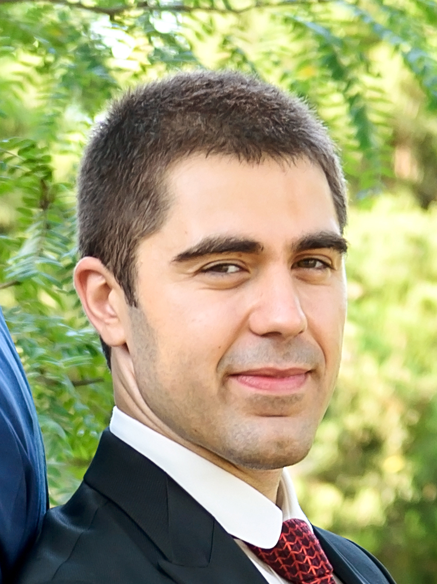
Zhivko Petrov
Perception Robotics Software Engineer
5+ years of experience in the gaming industry and robotics
Interested in Game Development and Robotics

Slide 16



Course Web Site, Forum and FB Group
Official web site:
Official discussion forum:
Official Facebook group:
https://softuni.bg/trainings/3556/applications-development-with-c-plus-plus-october-2021
https://softuni.bg/forum/categories/824/cplusplus-applications-development
https://www.facebook.com/groups/ApplicationsDevelopmentwithCplusplusOctober2021

Slide 17
Questions?
Notes:
17

Slide 18










SoftUni Diamond Partners

Slide 19



Educational Partners

Slide 20

License
This course (slides, examples, demos, exercises, homework, documents, videos and other assets) is copyrighted content
Unauthorized copy, reproduction or use is illegal
© SoftUni – https://about.softuni.bg/
© Software University – https://softuni.bg
Notes:
20

Slide 21
Trainings @ Software University (SoftUni)
Software University – High-Quality Education, Profession and Job for Software Developers
softuni.bg, about.softuni.bg
Software University Foundation
softuni.foundation
Software University @ Facebook
facebook.com/SoftwareUniversity
Software University Forums
forum.softuni.bg
Notes:
21

